Slide 1

Vulture mine tailings
Nicolas Boon
Audrey Lang
Nicole Stanczak

Slide 2
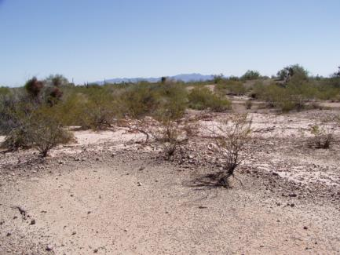
Site background
Wickenburg, Arizona
Gold mine
1863- Operation began
1942- Mine closed
Mined by open-cut methods
Treatment: Cyanide leaching
Tailing migration
Cloudbursts
Entered into a wash south of the mine
Figure 1: Wash south of Vulture Mine
Audrey Lang

Slide 3

Client, Tech advisor, stakeholders
Client
Bureau of Land Management (BLM)
Mr. Matt Plis
Dr. Bill Harris, PhD, PE
Technical Advisor
Dr. Bridget Bero
Stakeholders
BLM
United States and Arizona Citizens
[1]
Nicole Stanczak

Slide 4
Project overview
Examine and assess the risks that accompany the migration of mine tailings
Produce a Preliminary Assessment/Site Inspection (PA/SI) following the CERCLA process
Use results to determine if the BLM should proceed with further CERCLA actions
Audrey Lang

Slide 5
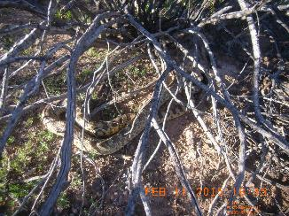
Work Plan
Details protocols to be followed when collecting samples
Contains Health & Safety Plan and Sampling & Analysis Plan
Health & Safety Plan provides:
Emergency contact information
Personal Protection Equipment
Details of chemicals being used
Descriptions of potential field encounters
Figure 2: Snake encounter
Nicolas Boon

Slide 6
Sampling plan
Created maps and identified the range of the site
Created a grid on the map to identify potential sampling spots
Soil Samples
160 Grid based soil samples
8 Background samples
32 Samples between Hot Spots and Random Spots
Nicole Stanczak

Slide 7
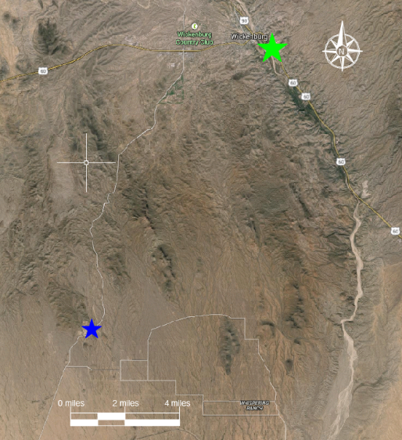
Location of Vulture mine
[2]
Nicole Stanczak

Slide 8
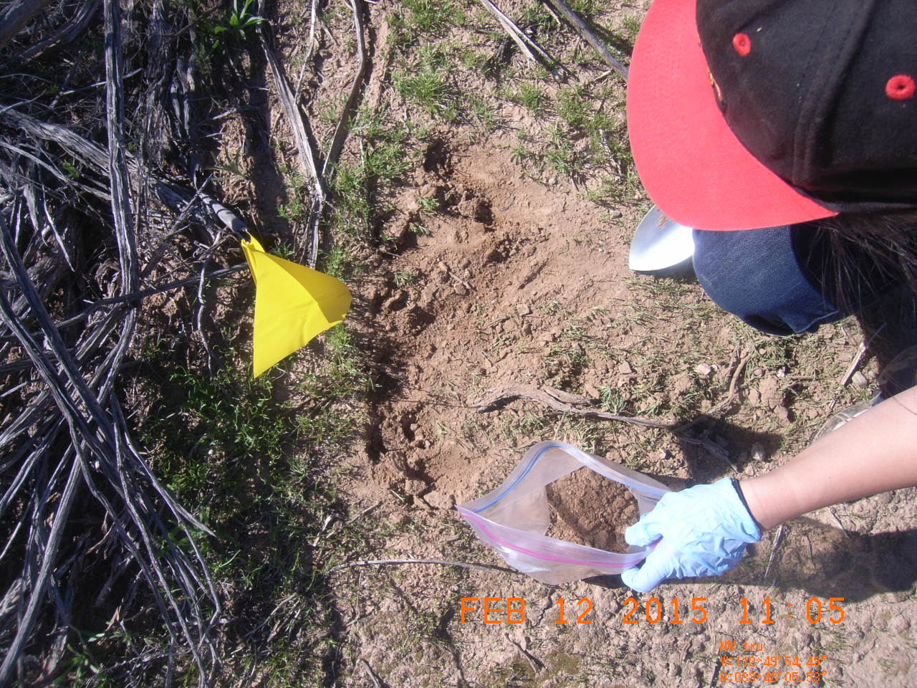
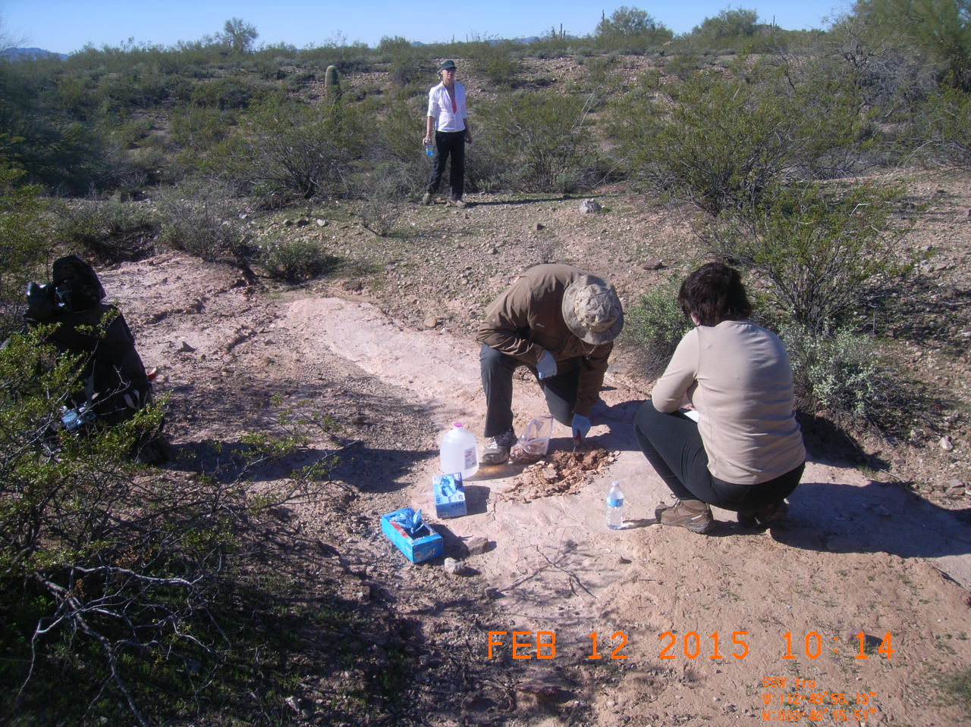
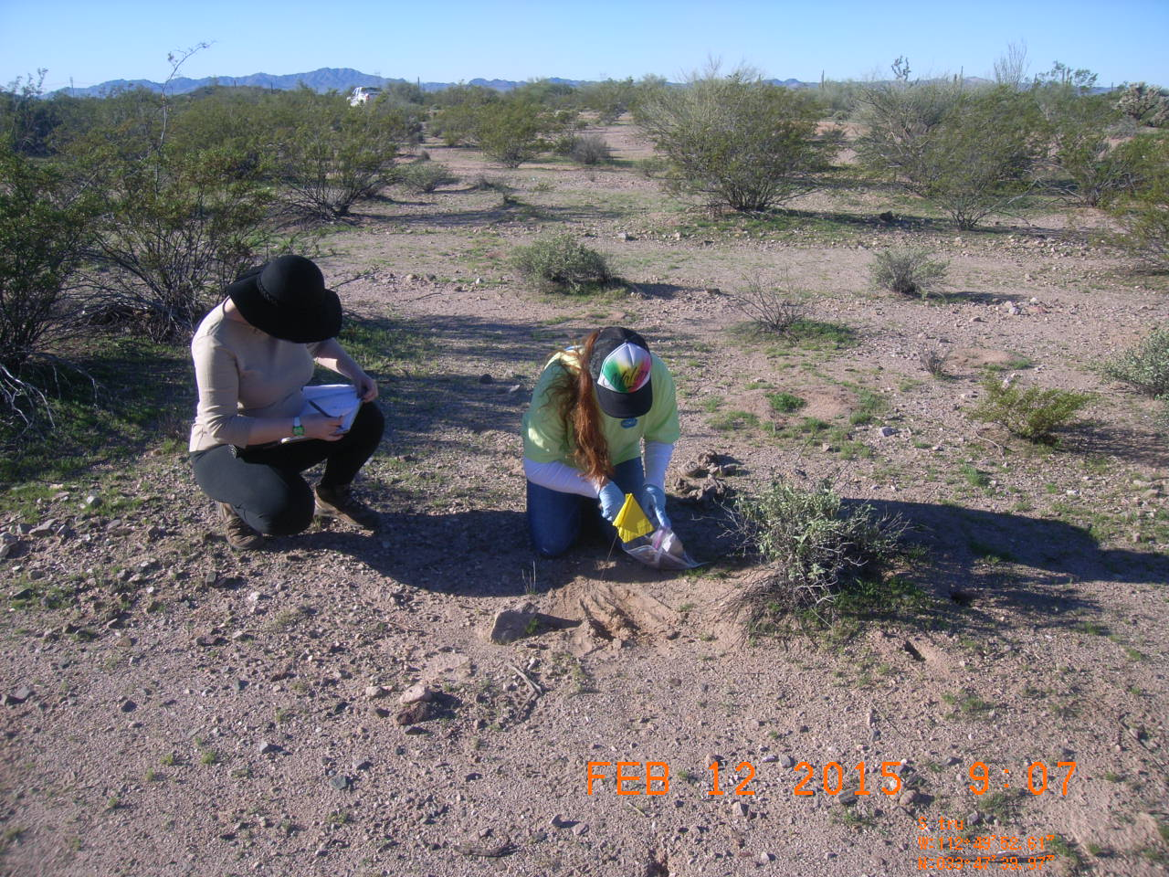
Field Sampling
75 Grid soil samples
4 Background samples
25 Hot spot samples
Figure 3: Grid soil sample collection
Figure 4: Hot spot soil sample
Figure 5: Grid soil sample collection
Nicole Stanczak

Slide 9
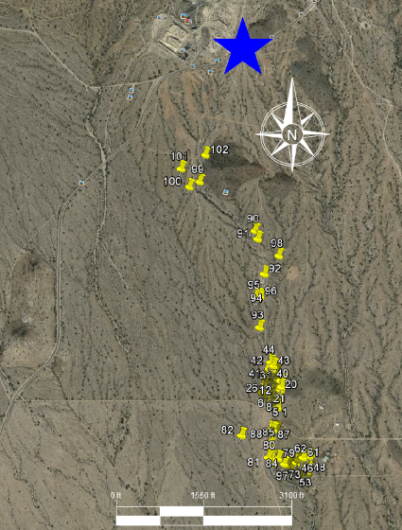
Sampling locations on the wash
[3]
Nicole Stanczak

Slide 10
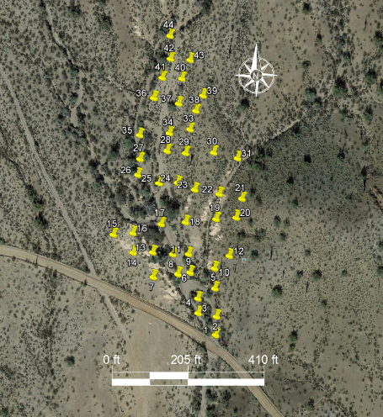
Gridded Section of the wash
[4]
Nicole Stanczak

Slide 11
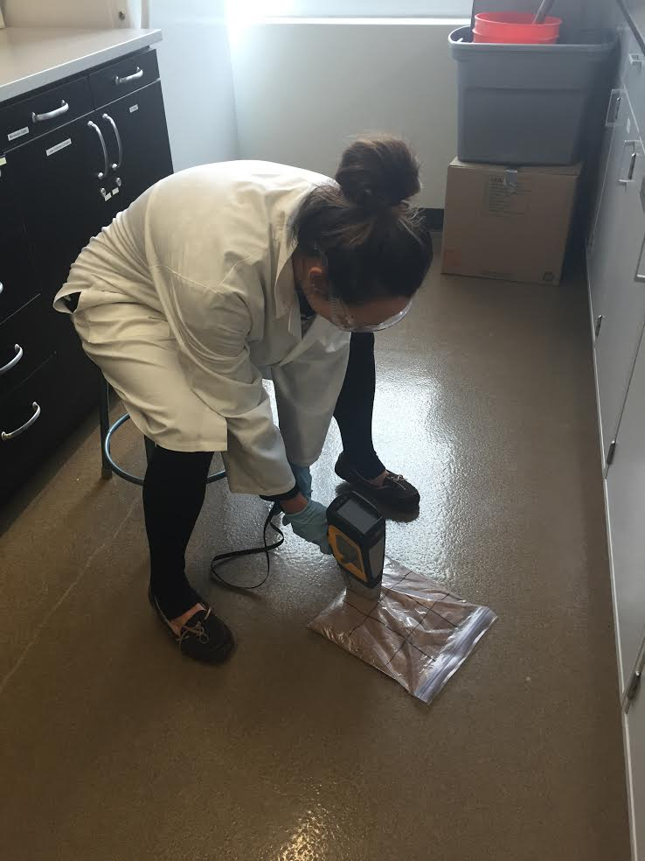
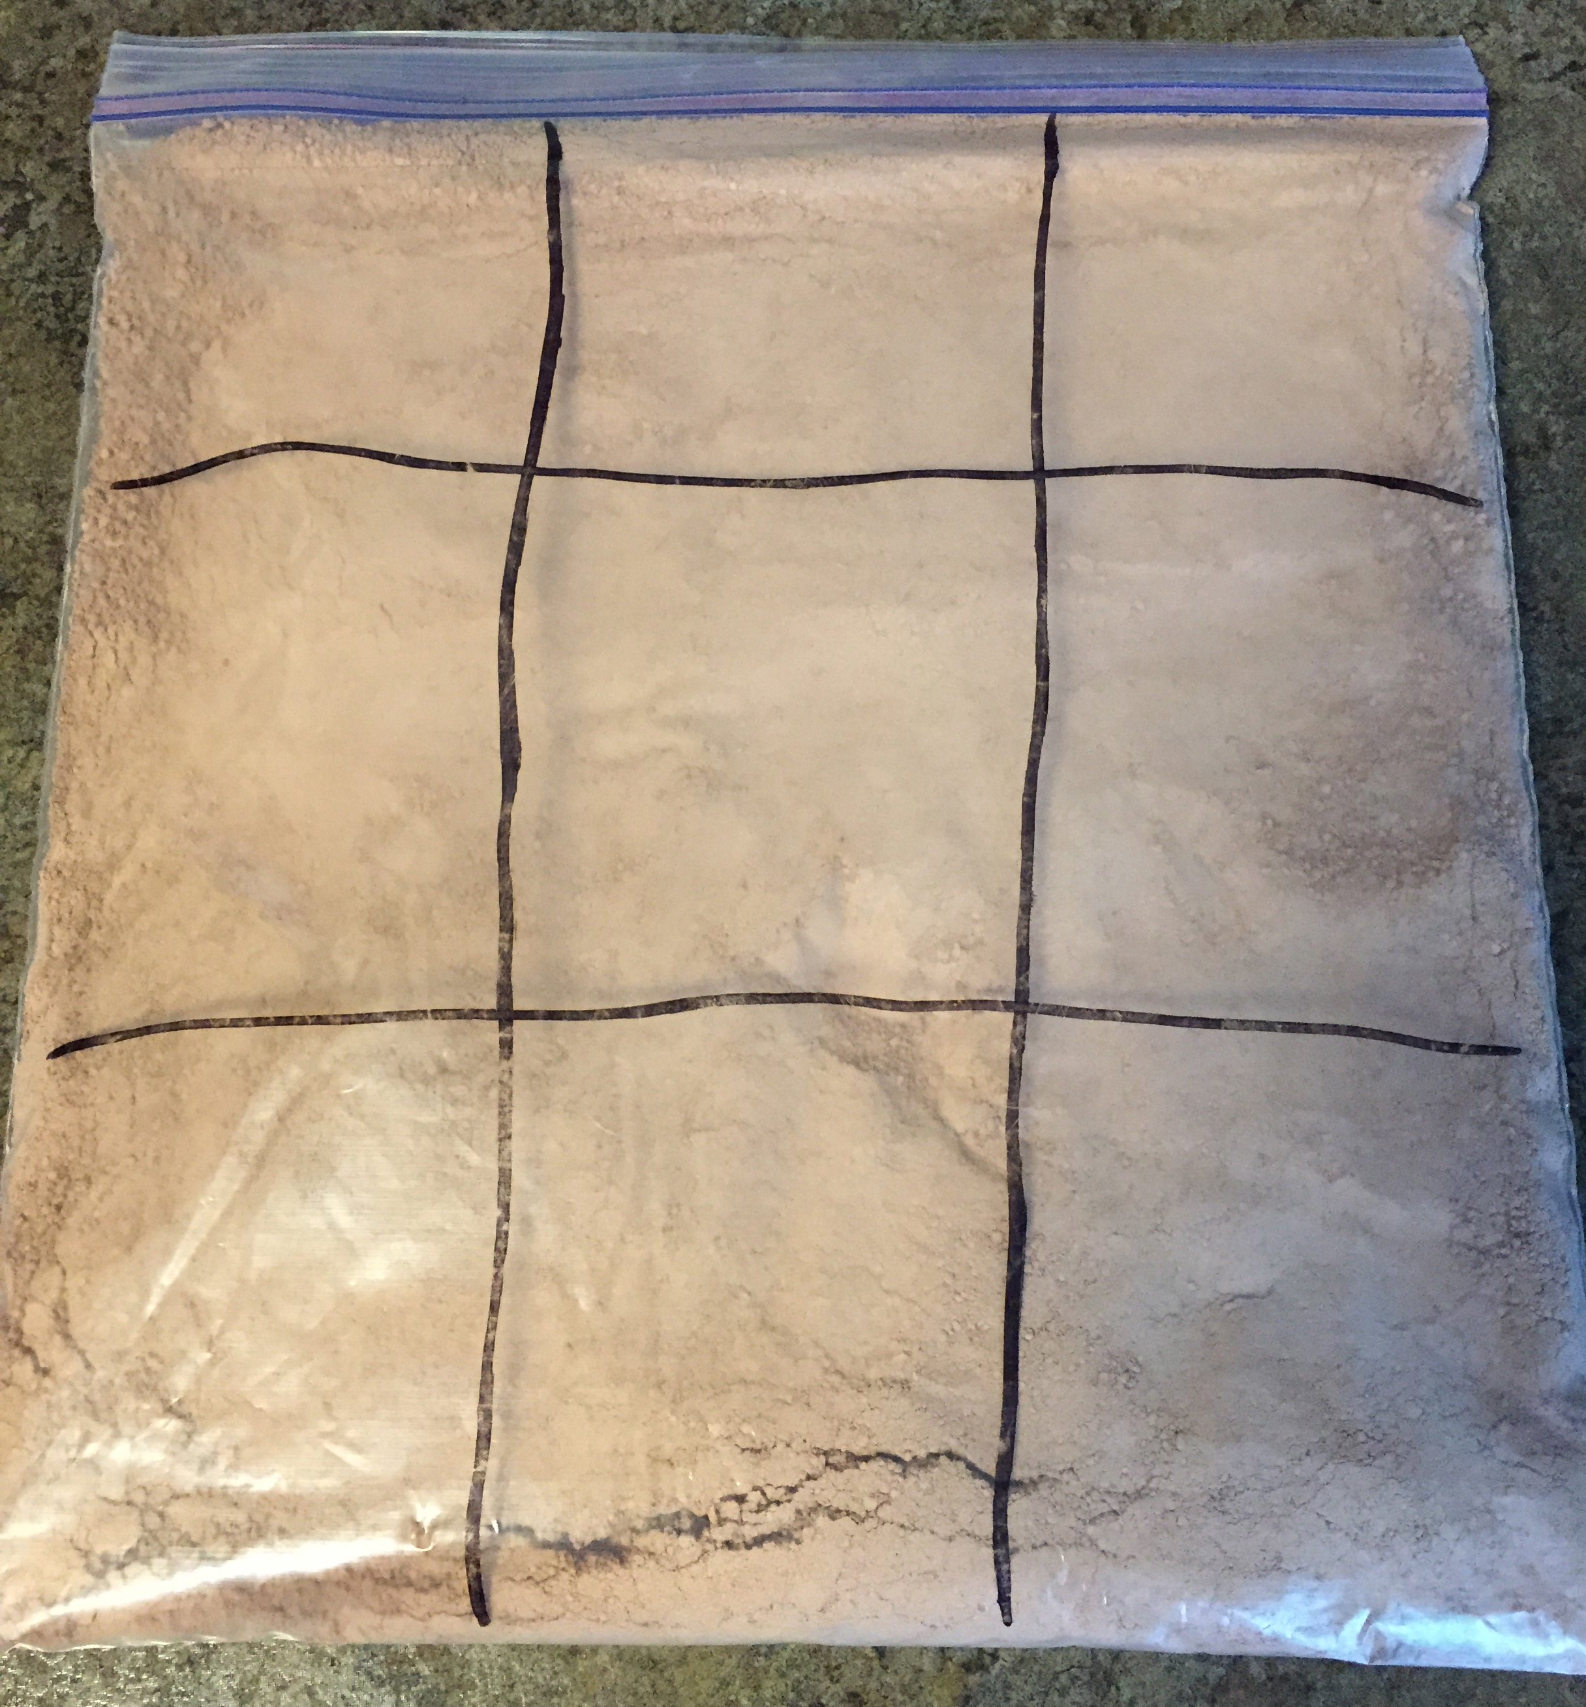
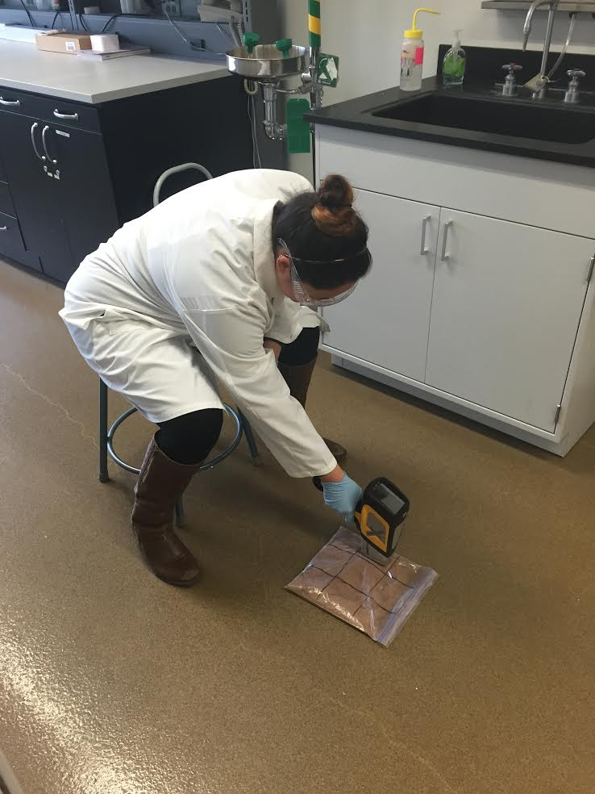
XRF Screening
Divide each bag into 9 sections
Drop the highest and lowest reading and take the average of the 7 readings
20% of samples sent to Environmental Analysis Laboratory
Figure 6: Nicole XRF screening
Figure 8: Audrey XRF screening
Audrey Lang
Figure 7: Soil sample

Slide 12
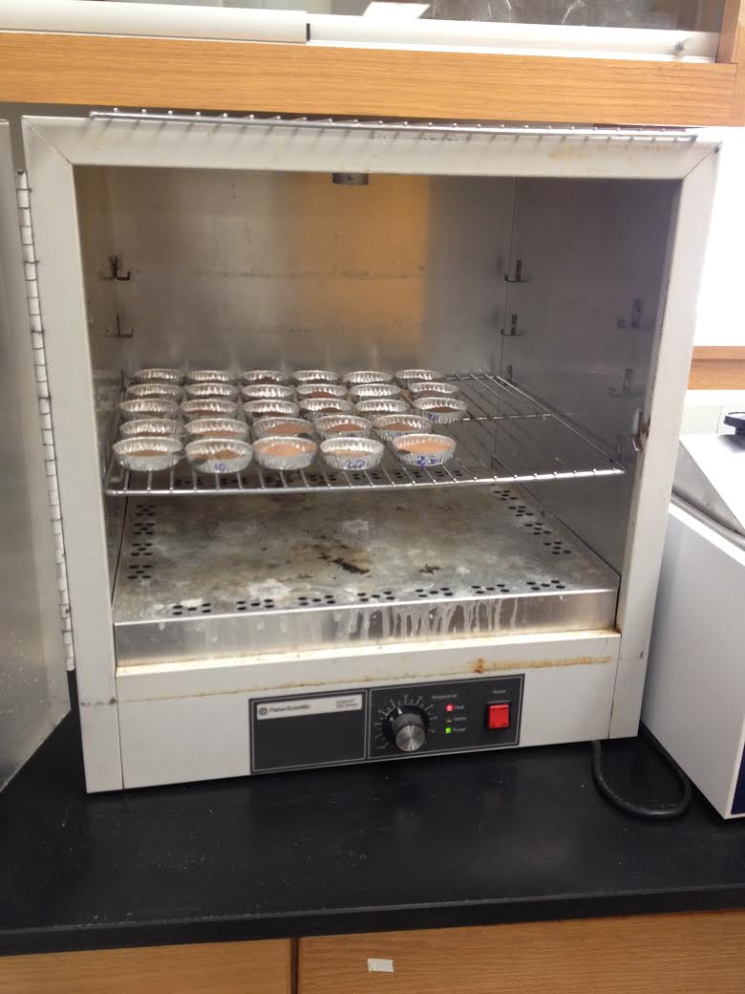
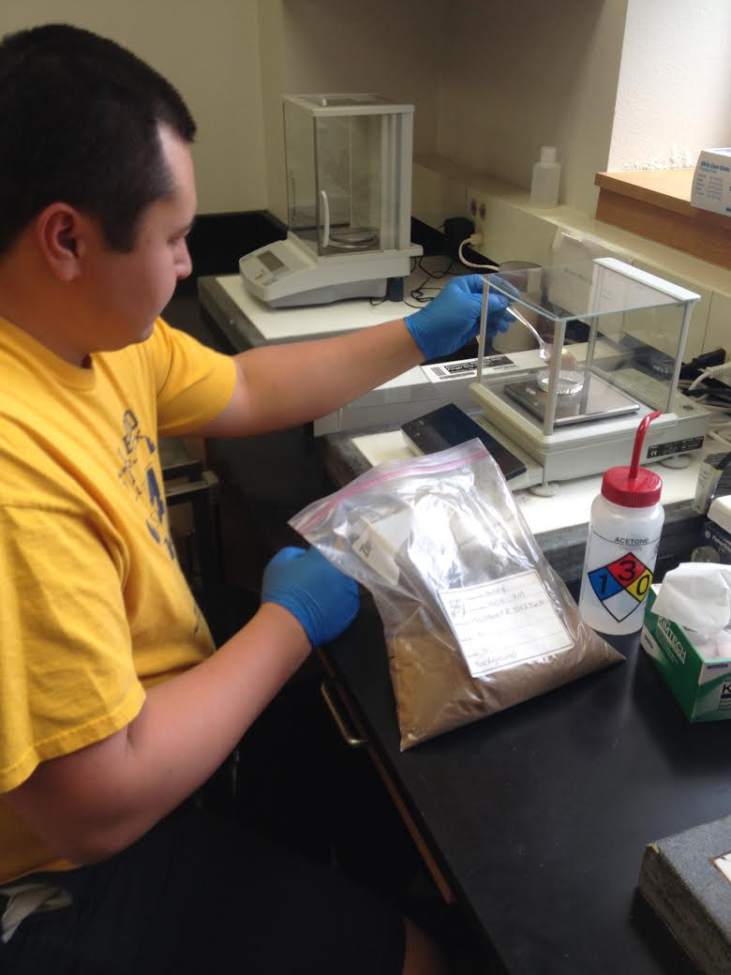
Metal Extractions
5g of each soil sample
Nitric Acid and 30% Hydrogen Peroxide
Cesium Sulfide and Lanthanum Sulfide
Figure 11: Drying soil samples
Figure 10: Nick weighing out samples
Audrey Lang

Slide 13
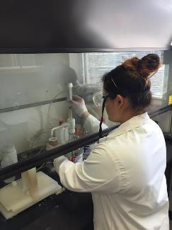
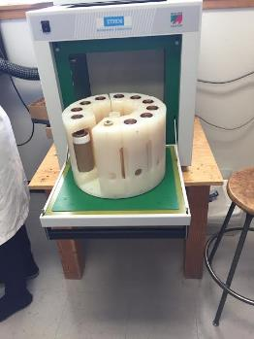
Total Metals Testing
Sample preparation
Microwave Digest
Figure 12: Addition of Nitric Acid to sample
Figure 13: Holding cells
Audrey Lang

Slide 14
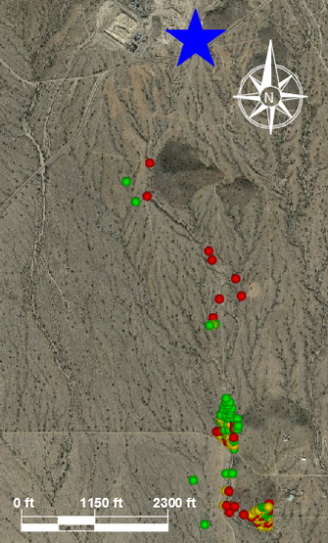
Concentration Mapping of Lead
Below Residential Remediation Level (0-399 mg/kg)
Below Non-Residential Remediation Level (400-799 mg/kg)
Higher Than Non-Residential Remediation Level (800+ mg/kg)
Nicolas Boon
[6]

Slide 15

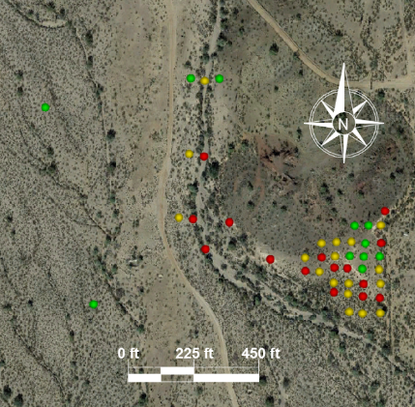
Concentration Mapping of Lead
[7]
[6]
Below Residential Remediation Level (0-399 mg/kg)
Below Non-Residential Remediation Level (400-799 mg/kg)
Higher Than Non-Residential Remediation Level (800+ mg/kg)
Nicolas Boon

Slide 16
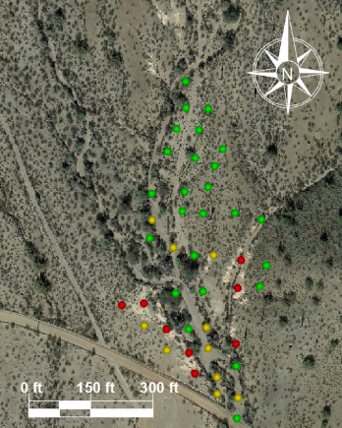
Concentration Mapping of Lead
[8]
[6]
Below Residential Remediation Level (0-399 mg/kg)
Below Non-Residential Remediation Level (400-799 mg/kg)
Higher Than Non-Residential Remediation Level (800+ mg/kg)
Nicolas Boon

Slide 17
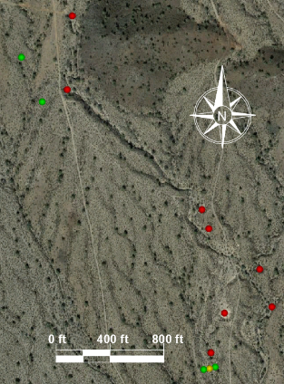
Concentration Mapping of Lead
[9]
[6]
Below Residential Remediation Level (0-399 mg/kg)
Below Non-Residential Remediation Level (400-799 mg/kg)
Higher Than Non-Residential Remediation Level (800+ mg/kg)
Nicolas Boon

Slide 18
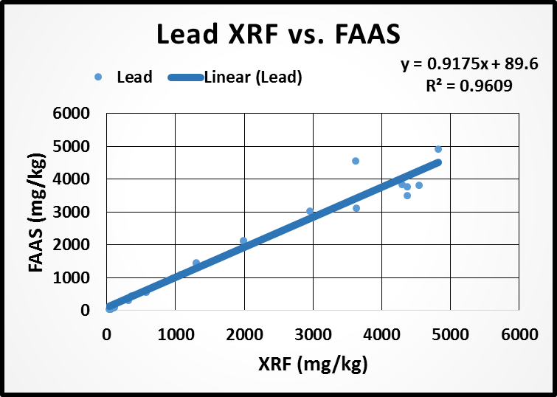
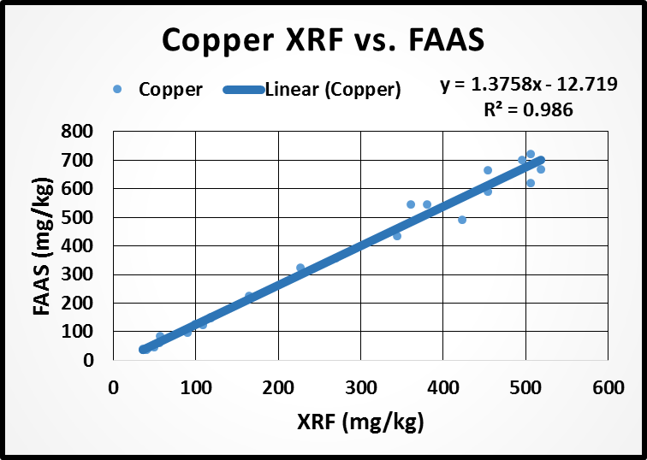
Data Correlations
Lead Correlation with XRF and FAAS Results
Copper Correlation with XRF and FAAS Results
Figure 15: Lead Correlation
Figure 16: Copper Correlation
Nicolas Boon

Slide 19
Soil Remediation levels
Nicole Stanczak

Slide 20
Risk Assessment Scenarios
Two human risk scenarios
Site worker
Recreational user
Adult Lead Model
Average concentration of lead = 1152 ppm
90% max concentration of lead = 4277 ppm
Audrey Lang

Slide 21
Average lead concentration
Calculations of Blood Level Concentrations: Adult Worker
Cases | Units | GSDi and PbBo from Analysis of NHANES lll
Target PbB level of concern | ug/dL | 10
PbB of adult worker, geometric mean | ug/dL | 4.8
95th percentile PbB among fetuses of adult workers | ug/dL | 14.6
Probability of fetal PbB > adult PbB | % | 12.9
Calculations of Blood Level Concentrations: Adult Recreational User
Cases | Units | GSDi and PbBo from Analysis of NHANES lll
Target PbB level of concern | ug/dL | 10
PbB of adult recreational user, geometric mean | ug/dL | 1.7
95th percentile PbB among fetuses of adult recreational user | ug/dL | 5.2
Probability of fetal PbB > adult PbB | % | 0.6
Audrey Lang

Slide 22
90% Max lead concentration
Calculations of Blood Level Concentrations: Adult Worker
Cases | Units | GSDi and PbBo from Analysis of NHANES lll
Target PbB level of concern | ug/dL | 10
PbB of adult worker, geometric mean | ug/dL | 13.7
95th percentile PbB among fetuses of adult workers | ug/dL | 41.9
Probability of fetal PbB > adult PbB | % | 61.2
Calculations of Blood Level Concentrations: Adult Recreational User
Cases | Units | GSDi and PbBo from Analysis of NHANES lll
Target PbB level of concern | ug/dL | 10
PbB of adult recreational user, geometric mean | ug/dL | 2.2
95th percentile PbB among fetuses of adult recreational user | ug/dL | 6.7
Probability of fetal PbB > adult PbB | % | 1.5
Audrey Lang

Slide 23
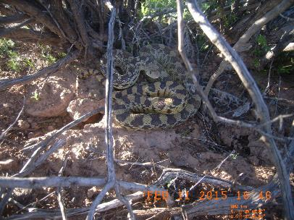
Ecological Risk Assessment
EPA Integrated Risk Information System (IRIS)
IRIS conducted studies on rats exposed to high concentrations of lead
These rats showed distinct characteristics such as the formation of tumors
Mammals and reptiles at the site are potentially at risk if these high level of lead are ingested
Nicole Stanczak
Figure 17: Snake found on site

Slide 24
Broader impacts
Environmental/Health
Hikers
Bikers
Wildlife and endangered species
Political
Controversial issues regarding cleanup of sites
Global
Example for other mining sites
Nicole Stanczak

Slide 25
Total Hours & personal costs
Personnel Cost
Position | Hours | Cost
Senior Engineer | 72 | $7,200
Environmental Engineer | 157 | $8,263
Lab Technician | 120 | $3,590
External Help | 72 | $1,900
Total | 421 | $20,953
Site Visit Expenses
Item | Rate | Cost
Transportation | $0.56/mile | $202
Hotel | $90/room | $270
Food | $8/meal | $160
Total |  | $632
Total Cost of Project
$21,914
Audrey Lang

Slide 26
Laboratory costs
Laboratory Costs for Metal Extractions
Metal Extractions | $/Sample | # of Samples | Cost
Synthetic Leaching | 4 | 28 | $112
Microwave Digest | 8 | 33 | $248
Total |  |  | $360
Laboratory Costs for FAA Testing
FAA Testing | $/Sample | # of Samples | Cost
Synthetic Leaching | 16 | 28 | $448
Microwave Digest | 16 | 33 | $512
Total |  |  | $960
Student Discount
Discount | M.E.+FAA Cost | Total
75% | $1,319 | $330
Audrey Lang

Slide 27
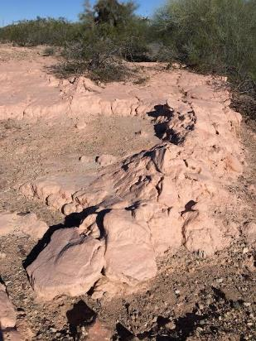
Conclusion
Correlations validate high concentrations of lead found at the site
Recommend BLM to take further action
Pursue a Potentially Responsible Party (PRP)
Remedial Action
Figure 18: Mine tailing pile
Audrey Lang

Slide 28
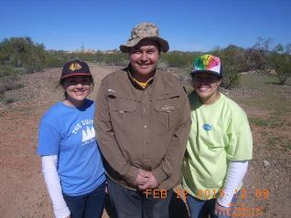
Acknowledgements
Thank you for all the help and support!
NAU
Dr. Bridget Bero
Jeff Propster
Gary Slim
Alina-Maria Davidescu
BLM
Mr. Matt Plis
Dr. Bill Harris
Jason Frels
Eric Zielske
Sincerely,
Gold Member Inc.

Slide 29
References
[1] Kuer. 2013. By Nicole Nixon
[2] Google Earth: Wash Outline Samples. The Vulture Mine- Wickenburg, AZ. Available: [https://www.google.com/earth/]
[3] Google Earth: location of soil samples taken. The Vulture Mine- Wickenburg, AZ. Available: [https://www.google.com/earth/]
[4] Google Earth: Gridded north section of wash. The Vulture Mine- Wickenburg, AZ. Available: [https://www.google.com/earth/]
[5] Google Earth: Location of soil samples taken. The Vulture Mine- Wickenburg, AZ. Available: [https://www.google.com/earth/]
[6] Google Earth: south section of wash. The The Vulture Mine- Wickenburg, AZ. Available: [https://www.google.com/earth/]
[7] Google Earth: central section of wash. The Vulture Mine- Wickenburg, AZ. Available: [https://www.google.com/earth/]
[8] Google Earth: north section of wash. The Vulture Mine- Wickenburg, AZ. Available: [https://www.google.com/earth/]

Slide 30
Questions???

